Slide 1
Week 13 AP Macroeconomics

Slide 2
The Spending Multiplier
We have defined the AD/AS Equilibrium and the existence of output gaps.
One concept that ties in with this is that of the multiplier effect.

Slide 3

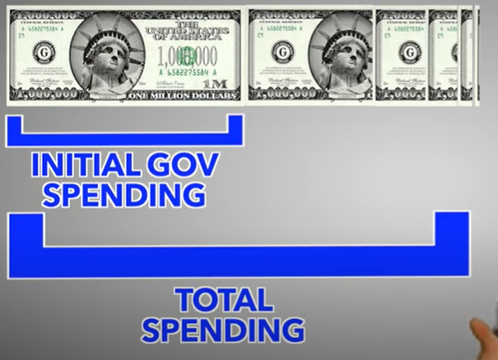
Fiscal Policy and the Multiplier
We have looked at how government can increase spending through fiscal policy.
We will soon see that this can have a multiplied effect.

Slide 4

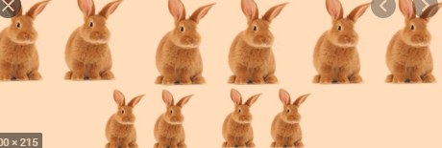

Slide 5




You worked last month and got paid 1000 dollars.
What do you do with this money?
Consume
(Spend money on goods and services in the country)
Save

Slide 6



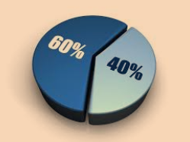
People’s Spending Habits Vary
Some people spend a lot.
Eg. Spend 1000 and save 0
Some people save a lot.
Eg Spend 200 and save 800.
Most people would be somewhere in the middle.
Eg. Spend 600 and save 400.
If we take the average of everyone then we could find a percentage for society. Eg. The average person spends 700 and saves 300.
How much would you spend if you had 1000 dollars?

Slide 7
Marginal Propensity to Consume (MPC)
Marginal = ‘the last dollar’
Propensity = ‘what you usually do’
Consume = buy
Therefore, the marginal propensity to consume is the proportion you spend of your additional income. Ie. How much you spend of the last dollar you received.
We shorten it to MPC.
∆C
Summary
The MPC (marginal propensity to consume) is how much you spend of each extra dollar you earn.
MPC = ∆C / ∆Income
∆MPC =
∆Income
Example
If you spend $600 and out of $1000 then your MPC is:
MPC = 600/1000 = 0.6

Slide 8
Marginal Propensity to Save (MPS)
Marginal = ‘the last dollar’
Propensity = ‘what you usually do’
Save = save
Therefore your Marginal Propensity to Save is the proportion you save (MPS)
Summary
MPS (marginal propensity to save) is the amount that one saves of each extra dollar of income.
MPS = ∆S / ∆Income
Example
If you spend $600 then you must save $400 dollars. (Remember we start with $1000.)
Marginal Propensity to Save =
MPS = $400/$1000 = 0.4
∆S
∆MPS =
∆Income

Slide 9
MPC and MPS
Summary
MPC + MPS = 1
MPS = 1-MPC
Note that the two always sum to 1. MPC + MPS = 1
In our example:
MPC = 600/1000 = 0.6
MPS = 400/1000 = 0.4
MPC + MPS = 0.6 + 0.4 = 1
So MPS = 1 - MPC
So if we already have the MPC for example, we can find the MPS very easily. Eg. if the MPC = 0.8 (we spend 80% of our money) then MPS = 1-0.8=0.2 (we save 20% of our money)
Note: This is because we assume that we can only do two things – spend and save.

Slide 10
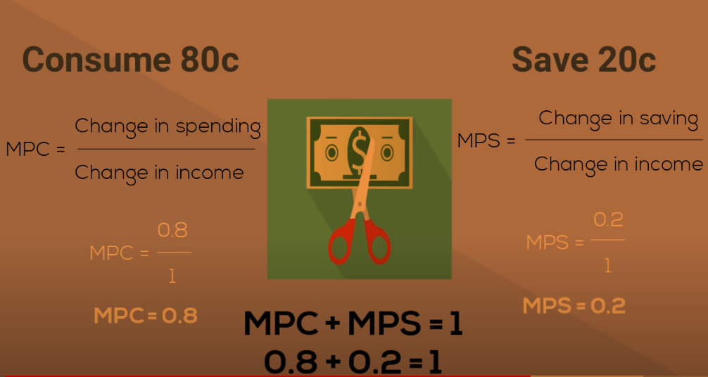

Slide 11
Quick Revision
Marginal Propensity to Consume
Marginal Propensity to Save
What does MPC stand for?
What does MPS stand for?
Question:
People in a country earn 5000 dollars every year on average.
They spend 3500 dollars and they save 1500 dollars.
What is their MPC?
What is their MPS?
What is 1-MPC?
What is MPC + MPS?
3500/5000 = 0.7
1500/5000 = 0.3
1-0.7 = 0.3 (the same as above)
0.7 + 0.3 = 1

Slide 12
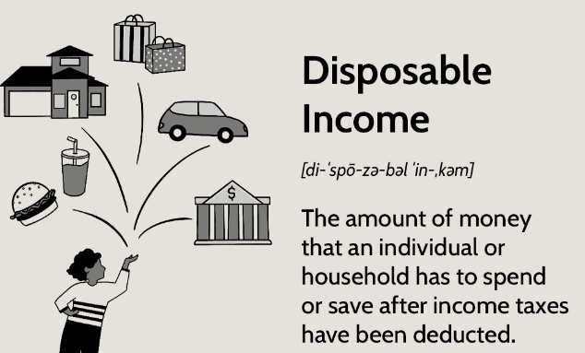
Disposable Income
When we talk about the MPC and the MPS, we are talking about how much is spent out of people’s disposable income.
Disposable income is the money that you really have available to spend
Disposable income (Y_{D})= Gross income – Tax
Gross income = the income before we make any subtractions
Eg. You are paid a salary of $50,000 a year but must pay 20% income tax.
Disposable income = 50,000 – 0.2x50,0009 = 40,000

Slide 13
What is the difference between disposable income and gross income?
Disposable income is gross income – tax.
It is the amount you really have to spend.
Which is larger? Gross income or Disposable income?
Gross

Slide 14
Multipliers
We’ve covered the necessary definitions of MPC and MPS
Now we can cover how this relates to spending being multiplied through the economy.

Slide 15


Spending = Income = Spending etc.
When I spend money, it is Person B’s income.
Then Person B spends some of their income and it is Person C’s income.
Then Person C spends some of their income and it is Person D’s income.
So… One person’s spending = another person’s income.
Conclusion: More spending = More income = More spending etc.
We can see that the original money you spend becomes a lot more money in the economy. This is why we call it the multiplier.
Note: The spending gets smaller each ‘round’ of spending.
So the multiplier is not infinite, because we will eventually reach a limit.
Summary
One person’s spending becomes another person’s income which is spent again and again and again.
This creates a ‘multiplier effect’

Slide 16

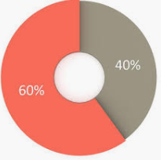
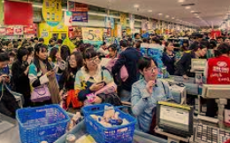


How Spending Multiplies Example
When anyone spends money in the economy, that money will be respent again and again.
So $1 spent creates more than $1 change in the economy’s spending.
This is the multiplier effect.
Example
You live in a town.
Everyone you know spends 60% of their money and saves 40% of their money.
What is their MPC?
0.6
What is their MPS?
0.4
When you spend 100RMB at KFC, where does it go?
The owner of the business takes the 100RMB.
His MPC = 0.6 so he spends 60RMB at the grocery store (for example) (and saves 40 RMB)
The owner of Wumart gets the 60RMB and spends 60% of this and saves the rest.
He spends 60*0.6 = 36RMB to get a haircut.
The barber takes the 36RMB and
He spends 36*0.6 = 21.6RMB to buy a flower for his wife.
Summary
After money is spent once, it is spent many other times.
These ‘rounds of spending’ sum to the total amount spent.
This is the multiplier effect.

Slide 17
Adding the total amount of spending.
How much was spent in our example?
You: 100RMB
Owner of KFC: 100 x 0.6 = 60RMB
Owner of Wumart: 100 x 0.6 x 0.6 = 36RMB
Barber: 100 x 0.6 x 0.6 x 0.6 = 21.6RMB
Florist: 100 x 0.6 x 0.6 x 0.6 x 0.6 = 12.96RMB
etc.
What is the total amount of spending?
Using math skills we can derive a formula to calculate the limit. This derivation is not covered, so we can simply use the formula.

Slide 18

Mathematically
x + ax + a²x + a³ x + a⁴ x + a⁵x + a⁶x + a⁷x + … + a^{n}x
= x . (1 /1-a)
How do we arrive at this? Try asking your maths teacher!
Eg. 100 + (0.6x 100) + (0.6² x 100) + (0.6³ x 100) + (0.6⁴ x 100) + (0.6⁵ x 100) etc.
= 100 + 60 + 36 + 21.6 etc.
= 100 . (1/(1-0.6)
= 250

Slide 19

The Multiplier Formula Conclusion
The limit part of the calculation, called the multiplier is given by:
Remember that MPC + MPS = 1
Conclusion: Our original $100 creates $250 of total spending.
This is why we call it the spending multiplier. Because the original amount of money multiplies in the economy.
We times the multiplier by the original money spent.
∆Total Spending = ∆Original spending x Multiplier
= ∆Original spending x 1/(1-MPC)
∆Total Spending
= ∆AD
= ∆GDP
= ∆Real Output
= ∆Y
In our example:
Multiplier = (1/(1-0.6) = 2.5
Total Spending = 100 x 2.5
= 250

Slide 20
If the spending multiplier is 4, and an individual spends $300, what will be the effect on total spending in the economy?
Total spending = 300 x 4 = 1200
Why is there a multiplier effect?
Because when person A spends, person B’s income increases which increases their spending etc.
If total spending has changed in the economy by $1200, what other things can we say have changed?
AD
GDP
Y
Real Output
Real Income

Slide 21


Multiplier Size
What happens to the multiplier and the economy’s spending if our MPC changes?
We can compare two situations with two different MPCs.
Eg. In an economic expansion when consumer confidence is high.
Eg. In an economic recession when consumer confidence is low.
If MPC = 0.8
Total Spending = 100*1/(1-0.8)
= 100*1/0.2
=100*5 (multiplier = 5)
= 500
If MPC = 0.4
Total spending = 100/(1-0.4)
= 100/0.6
=100*1.6667 (multiplier = 1.6667)
= 166
The bigger the MPC, the larger multiplier and therefore larger the effect on the economy!

Slide 22
When MPC increases, what happens to the multiplier?
It also increases, because the multiplier = 1/(1-MPC)

Slide 23
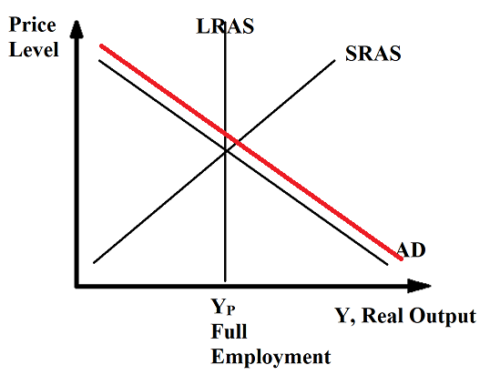
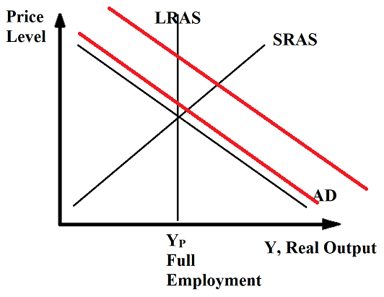
Multiplier – Effect on AD
Summary
The spending multiplier shows how an increase in spending has a larger effect on total spending /Aggregate Demand.
When we spend money in the economy, we increase total spending (ie. GDP) by more than the original amount.
We will soon see the policy implications of this.
Eg. You spend $100
Increase in AD
= $300
Multiplier
eg. 1/MPS = 1/(1-MPC) = 3

Slide 24
Spending Multiplier Effects
Summary
All spending (C,I,G,X-M) has a positive multiplier effect. Decreases in spending will have a negative multiplier effect.
All spending in the economy has a multiplier effect.
Consumption
Investment
Government Spending
Positive vs Negative effects
An increase in spending will have a positive multiplier effect.
However, a decrease in spending will have a negative multiplier effect.
When person A spends less, person B has less income and spends less, and so person C has less income and spends less etc.
Exports - Imports
Note: Exports = positive effect, Imports = negative effect (leakage)

Slide 25
If the multiplier in the economy is 4, and you spend 100 less than usual? What happens to total spending in the economy?
Change of spending = -100 x 4 = -400

Slide 26
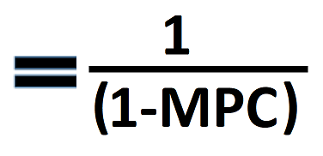
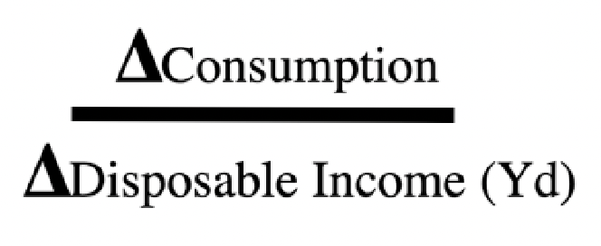
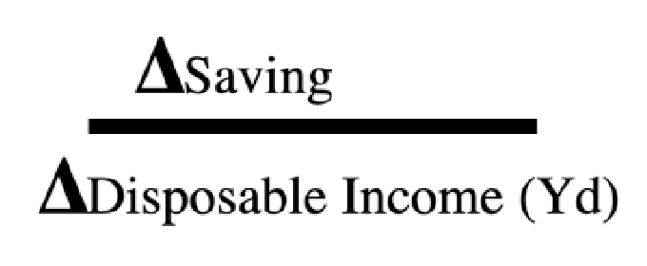
Multiplier Formulas
Spending Multiplier
MPC (Marginal Propensity to Consume)
MPS (Marginal Propensity to Save)
Change of Spending
∆Total Spending = ∆Original spending x Multiplier
= ∆Original spending x 1/(1-MPC)
∆Total Spending
= ∆AD
= ∆GDP
= ∆Real Output
= ∆Y

Slide 27
Questions
What is the spending multiplier?
Shows how spending has a larger effect on the economy than the original amount spent.
Question: Ketut lives in Thailand. He spends 1000 dollars. The MPC in Thailand is 0.7
Calculate the spending multiplier
Calculate the total amount of spending created in the economy when he spent the money.
Multiplier = 1/(1-MPC) or 1/(MPS)
1. Multiplier =1/0.3 = 3.333
2. Total spending created = 1000 x 3.333 = $3,333

Slide 28
The government decreases spending by $100 million dollars. If the MPC = 0.4, what is the total effect on AD?
Total effect on AD = -100 million x 1/(1-0.4) = -166.67 million

Slide 29
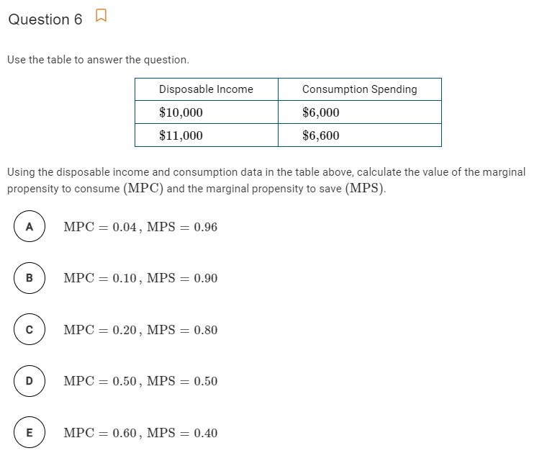
Answer:
Change in Income = 1000
Change in consumption = 600
Therefore MPC = 0.6
MPS = 1-0.6 = 0.4

Slide 30
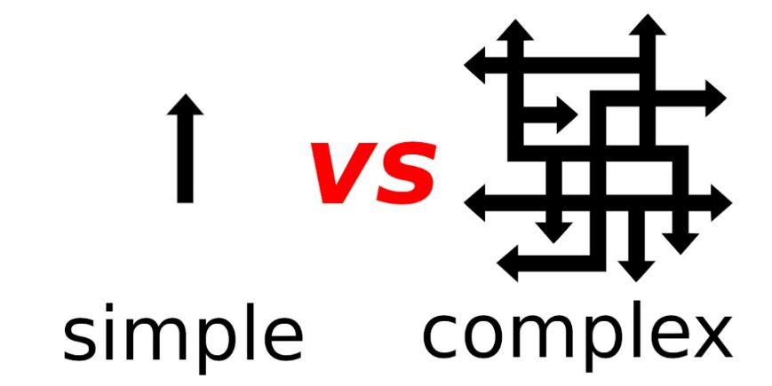

Simplifying Terms in Questions
Summary
Some terms such as: lump sum taxes, autonomous consumption and reference to international trade
- They simplify the question so that MPC isn’t affected.
In some of these questions we will see some seemingly confusing terms and changes to factors such as:
Lump sum taxes
Autonomous consumption/investment
No international trade
These terms are actually used to simplify the question and so for these questions the MPC will not be affected.
Because the real economy is complex, many factors affect each other which would make the question more difficult.
Lump Sum Tax
Tax that is paid by everyone regardless of income, consumption or other factors.
Eg. We live in a country where everyone must pay $100 in tax at the beginning of the year.
Therefore the MPC won’t be affected.
Autonomous consumption/investment
Spending that happens regardless of income.
Eg. You make $500 a year and spend $100. You make $1 million a year and spend $100.
Therefore the MPC won’t be affected.
No International Trade
Without any international trade, people can only buy within their country.
Therefore there won’t be any spending that will reduce the MPC and so the MPC won’t be affected.
Autonomous investment – not affected by outside variables
Investment – could be affected by many variables

Slide 31
Do we have to consider how taxes affect different parts of the economy such as the MPC if we have lump sum taxes?
No, it is the most simple version of tax that does not affect and is not affected by other variables.
Do we have to think of autonomous investment as any different to investment?
No.
Do we have to think of autonomous consumption as any different to consumption?
No.

Slide 32
Multiplier Summary
MPC + MPS = 1
Multiplier
∆GDP = ∆Original spending x Multiplier
= ∆Original spending x 1/(1-MPC)

Slide 33
(400 Questions)
If the marginal propensity to save is 0.9, then the marginal propensity to consume is
0.1
0.3
0.9
1.0
10.0
Answer: MPC + MPS = 1 therefore, MPC = 0.1

Slide 34
If the marginal propensity to consume equals 0.8, then the multiplier is
2
3
5
8
10
Answer: spending multiplier = 1/(1-MPC) = 1/(1-0.8) = 1/0.2 = 5

Slide 35
If the marginal propensity to consume increases, which of the following is necessarily true?
The marginal propensity to save decreases
The marginal tax rate increases
The economy is nearing full employment
Consumption is unaffected when income changes
The unemployment rate increases
Answer: A, because MPC + MPS =1, an increase in MPC means a decrease in MPS

Slide 36
The value of the spending multiplier increases when
the marginal propensity to save decreases
government spending decreases
tax rates are increased
imports increase
exports decrease
Answer: Multiplier = 1/MPS, Therefore as MPS decreases, the multiplier increases
Therefore, A

Slide 37
Terry’s marginal propensity to consume is 0.8. Last year he earned $50,000 in disposable income and spent $45,000. If Terry’s disposable income this year increased to $60,000, his consumption spending increased by
$4,000
$5,000
$8.000
$9.000
$10,000
Answer: MPC = change of consumption/change of income
Therefore change of consumption = MPC x change of income
Therefore change of consumption = 0.8 x (60,000 – 50,000) = 8000

Slide 38
Suppose that the marginal propensity to consume is equal to 0.8 in a closed economy with only lump-sum taxes. What is the maximum increase in output that can be caused by a $50 billion increase in government spending?
$40 billion
$50 billion
$100 billion
$250 billion
$400 billion
Change GDP = Change G x Multiplier
= 50 bn x 1/(1-0.8) = 50 x 5 = 250bn

Slide 39
Which of the following statements about the marginal propensity to consume is true?
It is always equal to the money multiplier.
It is equal to the percentage of total income that is spent on consumption.
It increases as individuals increase their savings.
It determines the size of the spending multiplier.
It is always equal to the marginal propensity to save.
Answer: D, we will soon see why B is not correct.

Slide 40
Government Multipliers
Governments also spend!
So their spending will also have a multiplier effect. But they also raise tax. What effect does this have?

Slide 41
Effect of Government Spending
Simply put, an initial increase in any part of C+I+G+(X-M) will cause a total effect that is larger than the initial increase because of a ‘ripple effect.’
Eg. Government spending G of $1 million will have a > than $1 million effect
The effect on AD will be larger than the initial change if the multiplier is more than 1.

Slide 42




Government Spending Multiplier
When the government spends (eg. Fiscal Policy) money it has the same spending multiplier effect!
This is the same multiplier we use for all the different spending (C, I, G, (X-M))!
Ie. multiplier = 1/MPS or 1/(1-MPC)
In fact, C, I, G, X will all have the same multiplier effect.
Summary
Government spending, Investment, Exports have the same multiplier effect as consumption.
= 1/(1-MPC) = 1/MPS

Slide 43
If the government spends $500 million increasing military spending, what will be the total effect on the economy if the MPC = 0.75.
∆GDP = ∆G x 1/(1-MPC) = +500 x 1/(1-0.75) = 500 x 4 = 2000
= 2000 million = +2 billion

Slide 44
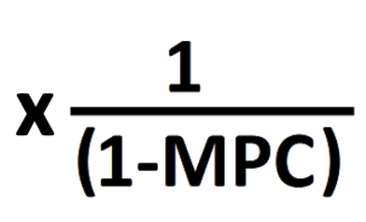

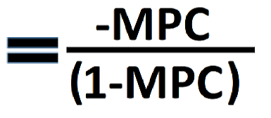
Government Tax Multiplier
Government Tax Multiplier:
Remember that tax is a leakage and therefore the government tax multiplier is negative because the money is taken out of your pocket so you can’t spend it.
However, the money you are taxed would not have been completely spent.
Let’s say the government taxes you $500 and your MPC = 0.8 (spend 80% of additional income)
You would have spent some of this money… but not all of it! you would have only spent $400 dollars.
So the money taken out of the economy is only 80% of the amount taxed… ie. the MPC
That $400 would have seen the same multiplier and so we multiply this by the same multiplier
MPC
A non-textbook way of expressing it is 1 less than the regular multiplier… we have 1 less round of spending (only 80% of the first round for example)
Summary
Government spending multiplier = normal multiplier
Government tax multiplier = negative in value because it reduces spending and it is not as large as the normal multiplier.
Spending Multiplier
Government Tax Multiplier

Slide 45
What is the formula for the tax multiplier?
- MPC / (1-MPC)
Why is it negative?
Because tax will decrease spending in the economy.
Why is it multiplied by the MPC on the numerator?
Because when you are taxed $x you would have spent MPC.x of that money.
Eg. If you are taxed $500, you might have spent $400.

Slide 46
Government Multipliers
Summary
Gov spending multiplier > Gov tax multiplier
Gov can increase GDP by taxing then spending
Government Spending
Government Taxation
Government Spending Multiplier = 1/(1-MPC)
Government Taxation Multiplier = -MPC x 1/(1-MPC)
Spending multiplier = Positive
>
Tax multiplier = Negative
One thing to note, is that the Government spending multiplier is larger than the Government Tax multiplier.
Therefore the government can increase the total expenditure = GDP even if the taxes are the same size as government spending.
Of course, in the real world it isn’t always that simple and the multiplier can be much smaller than anticipated, especially in a recession when confidence is low.

Slide 47
Example – When Government Spending and Tax are equal
Summary
Tax multiplier < Spending Multiplier
So if tax and government spending changes by the same amount, AD will still increase.
Government spends an extra $100 million.
Government increases tax by $100 million. MPC = 0.8
Will AD increase, decrease or remain the same?
Increase, but why?
Gov Spending
∆GDP= ∆Gov Spending x Spending Multiplier
= 100 x 1/(1-0.8) = $ 500 million
Gov Tax
∆GDP= ∆Tax x Tax Multiplier
= ∆Tax x (-MPC x 1/(1-MPC))
= 100 x -0.8 x 1 / (1-0.8)
= 100 x -4
= - $ 400 million
The spending multiplier is larger than the tax multiplier.
↑Spending, ↑AD

Slide 48
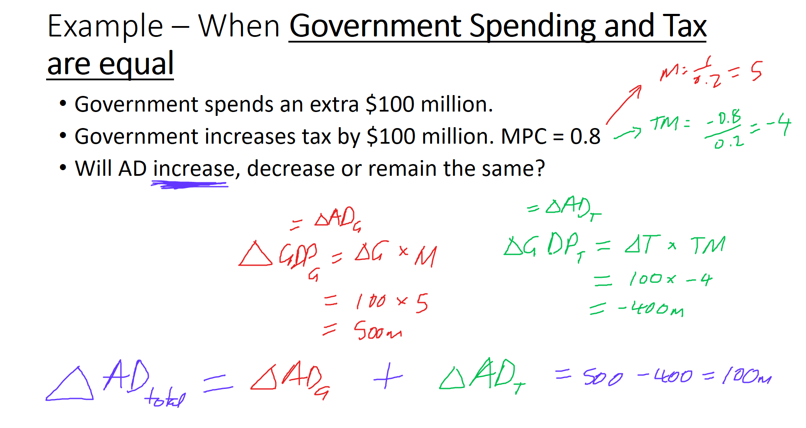

Slide 49
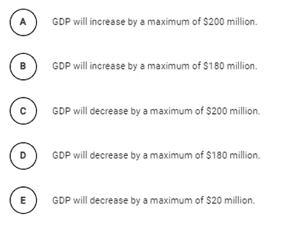
Tax multiplier = -MPC / (1-MPC)
= -0.9 / 0.1 = -9
Change GDP = Change tax x tax multiplier
= 20 x -9 = -180 million
Therefore GDP will decrease by 180 million
Answer: D

Slide 50
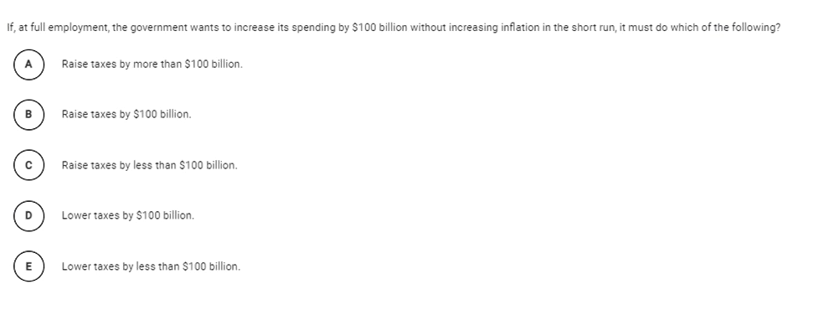
To prevent inflation, it must keep AD the same.
Therefore the taxes must balance out the government spending.
Remember that the Government spending multiplier > Government tax multiplier
1/(1-MPC) > MPC/(1-MPC)
Therefore the government would need to increase tax by MORE than they increased spending.
Answer: A

Slide 51
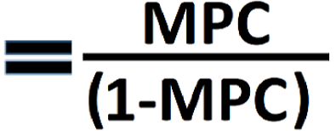


Transfer Payment Multiplier
Summary
Gov transfer payment multiplier = MPC/(1-MPC) = MPC/MPS
AD effect of government transfers is weaker than government spending.
Similar to the tax multiplier, the effect on the economy of a transfer payment is not direct.
Eg. If you receive $100 from the government you will spend according to your MPC. So you may only spend $80 if your MPC = 0.8.
Therefore the size of the transfer payment multiplier = MPC x the regular multiplier.
Spending Multiplier
Government Transfer Multiplier
Or 1/MPS
Or MPC/MPS
Because the transfer payment multiplier is smaller than the spending multiplier, the effect of government transfers will be smaller than government spending.

Slide 52
How much of a social security check of $1500 would be spent if an individual’s MPC = 0.75?
= 1500 x 0.75 = 1125
What is the formula for the transfer payments multiplier?
MPC/(1-MPC) = MPC / MPS
What is the total effect on spending in the economy?
= 1500 x transfer multiplier
= 1500 x 0.75/(1-0.75) = 1500 x 3 = 4500

Slide 53
Assume the economy has a MPC of 0.75. Which will have a greater effect on AD, government transfer payments of $100 million or government research spending of $100 million.
The government spending would have a bigger effect because government transfers are indirect because not all of the $100 million transfer will be spent.
Calculate the difference in effect of the two different policies.
Change AD_{G} = 100 x 1/(1-0.75) = 100 x 4 = 400 million
Change AD_{transfer} = 100 x 0.75/(1-0.75) = 100 x 3 = 300 million
Difference = 100 million

Slide 54
Multiplier Equations Summary
MPC = Marginal Propensity to Consume = ∆Consumption / ∆Disposable Income
MPS = Marginal Propensity to Save = ∆Saving / ∆Disposable Income
MPC + MPS = 1
Disposable Income (Y_{D}) = Income - Taxes
Spending Multiplier
Government Tax Multiplier
Government Transfer Multiplier
Or 1/MPS
Or -MPC/MPS
Or MPC/MPS
Government spending and tax at the same time.
∆GDP = ∆Income = ∆G x Multiplier + ∆Tax x Tax Multiplier
If the ∆Tax = ∆G, then AD will move in the direction of the spending because spending multiplier is larger than tax multiplier.
Effect on Economy:
∆AD = ∆GDP = ∆Income = ∆Initial Spending x Multiplier
∆AD = ∆GDP = ∆Income = ∆Tax x Tax Multiplier
∆AD = ∆GDP = ∆Income = ∆Transfer Payment x Transfer Payment Multiplier

Slide 55
Bonus: The Full Multiplier

Slide 56
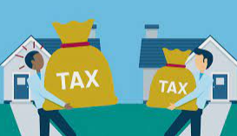



The Full Model Multiplier
Summary
The full multiplier assumes that people pay tax and buy imports as well as consume and save.
This will reduce the size of the multiplier.
Full Multiplier
The Basic Multiplier ignores things such as:
Tax paid
Import spending
The Full Multiplier is more accurate because we should add these to our multiplier formula.
Note: We will see shortly that this decreases the size of the multiplier.
Basic Multiplier
The Basic Multiplier assumes that consumers can only:
Consume (domestic production)
Save
The Multiplier = 1/MPS
Assumes people use money to:
Assumes people use money to:
Pay tax
Consume
Save
Consume
Save
Buy Imports

Slide 57
Simplified vs Full Circular Flow Model
Note: The lump sum tax will not affect the multiplier, unlike other taxes which will.
Full Model Multiplier
Simplified Multiplier
MPC (Marg. Prop. to consume)
MPS (Marg. Prop. to save)
Multiplier = 1/MPS or 1/(1-MPC)
MPC (Marg. Prop. to consume)
MPS (Marg. Prop. to save)
MPT (Marg. Prop. to pay tax)
MPM (Marg. Prop. to import)
Multiplier = 1/(MPS+MPT+MPM) or 1/(1-MPC)
The multiplier will be smaller because there will be less consumption in the economy (due to paying taxes and spending on imports)
Note: Even though the assumptions are different, the multiplier formula is still the same:
Multiplier = 1/(1-MPC)
Note:
You most likely don’t have to worry about the difference between the two because Multiplier = 1/(1-MPC) which is the same for both.

Slide 58
If we assume a more complex version of the economy where people can buy imports and have to pay more types of tax, what is the likely effect on the MPC?
It will decrease because people will not just be using their money for consumption.

Slide 59
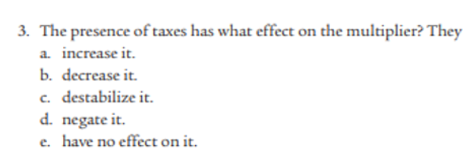
3. Decrease the multiplier
People will spend less of their income because of tax.

Slide 60
Alternate Multiplier Summary
Multiplier: Remember that the more people spend in the economy the larger the multiplier will be! Person A’s Spending = Person B’s Income, Person B’s Spending = Person C’s Income etc.
∆GDP= ∆Spending x Multiplier
Simplified multiplier = 1/MPS = 1/(1-MPC)
MPC = Marginal propensity to consume, MPS = Marginal propensity to save
MPC + MPS = 1
Applies to Consumption, Investment, Government Spending and Exports
Government Tax multiplier = -MPC/(1-MPC)
(Note: the tax multiplier is negative because it’s a leakage)
Tax Multiplier < Spending Multiplier
Government Transfer multiplier = MPC/(1-MPC)
Transfer Multiplier < Spending Multiplier
It is the same size as the tax multiplier but positive
Bonus: Full multiplier = 1/(MPS+MPT+MPM) = 1(1-MPC)
MPT = Marginal propensity to pay tax
MPM = Marginal propensity to import goods

Slide 61
Finish Module 21

Slide 62
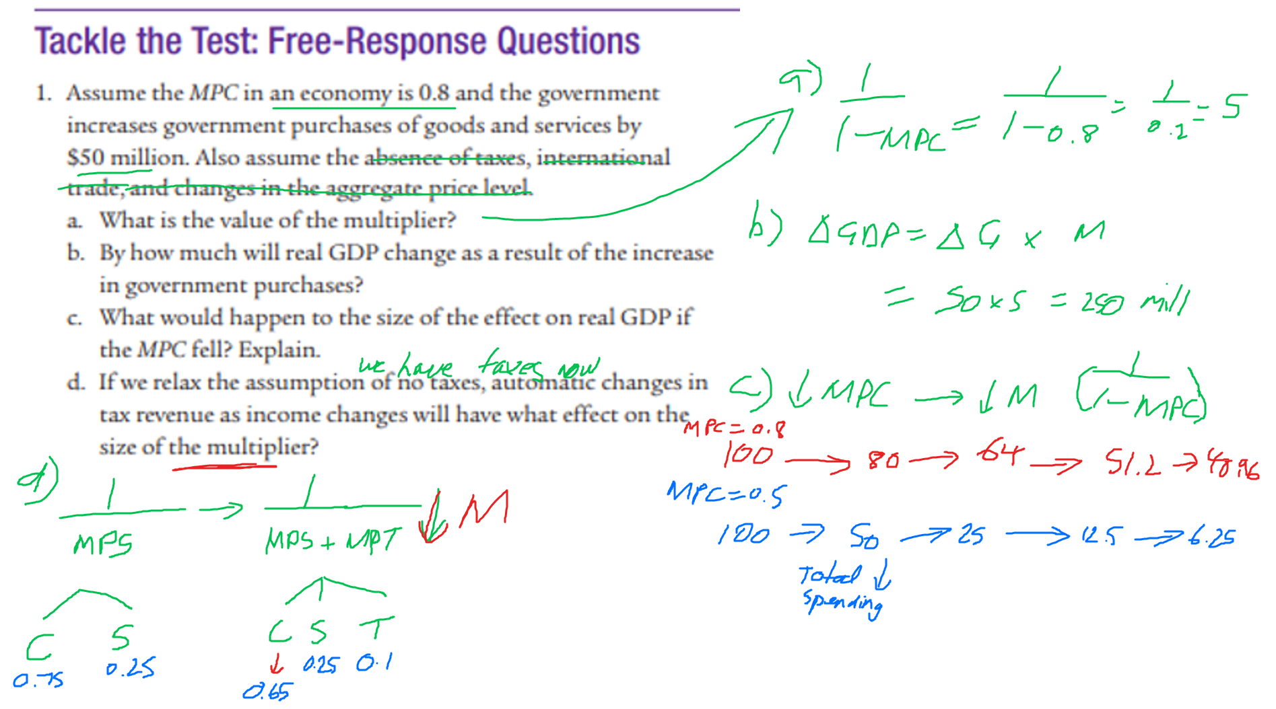

Slide 63
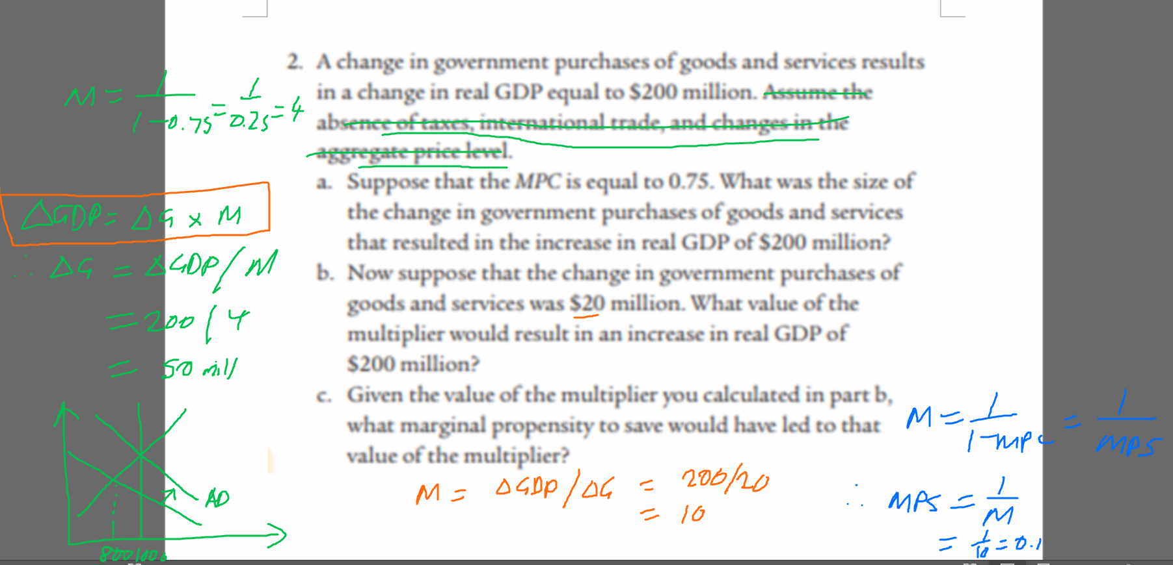

Slide 64
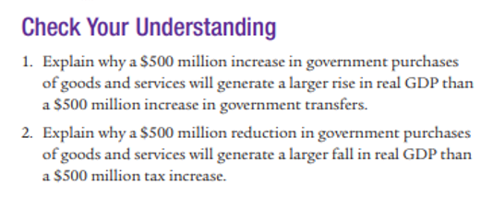
Module 21
1. The 500 million in Gov purchases would have a multiplier of 500 x multiplier. However the Government transfers would have a multiplier of < 500 million x multiplier because people will not spend the entire 500 million that they receive. So the change in spending may only be 500xMPC = 400 million.
2. The Gov spending multiplier is larger than the Gov tax multiplier because the tax multiplier will be –MPC/(1-MPC) because when people are taxed ‘X dollars’ they would not have spent < ‘X dollars’. Therefore the multiplier is smaller.
Gov spending: ∆GDP = ∆Original spending x (1/(1-MP)) = 500 x Multiplier
Gov Tax: ∆GDP = ∆Original spending x (-MPC)/(1-MPC)) = 500 x Smaller Multiplier

Slide 65
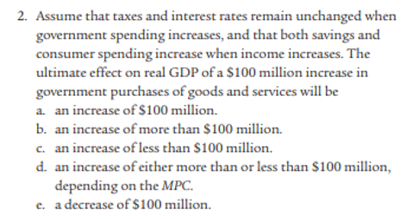
B. ∆GDP = ∆Original spending x Multiplier
Therefore more than 100 million.
Answer: B

Slide 66
Consumption Function
The graphical representation of the consumption function simply serves to complement our understanding of the Multiplier effect.
It is no longer part of the AP Macro Syllabus.
Summary
The following model is not going to appear in the AP exam but may strengthen your understanding of the MPC.

Slide 67
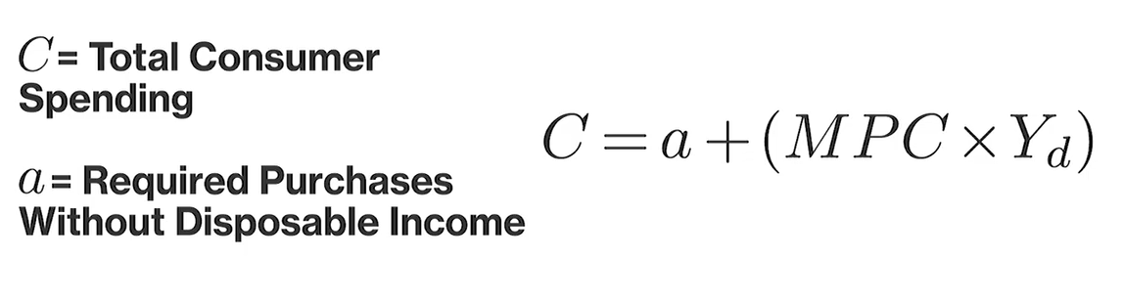
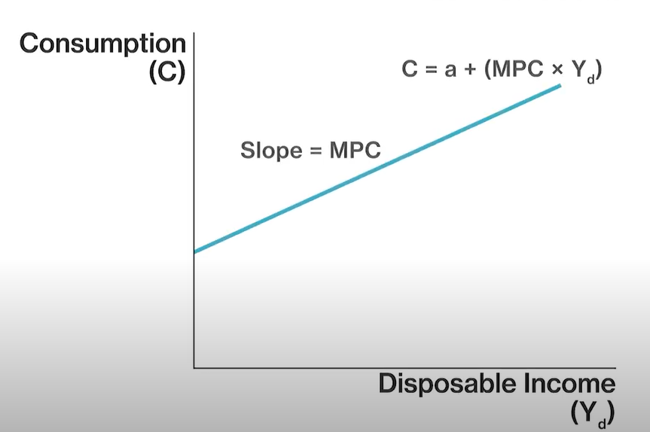
What does the consumption function show?
The Consumption function represents how consumption changes with Income.
Disposable Income Y_{d} is Income after tax that is free to be spent.
We can use the MPC (marginal propensity to consume) to represent the level of consumption (C), based on different income levels.
Because of the constant MPC, every extra dollar of Income leads to the same amount of extra spending.
See anything familiar?
MPC
Summary
The consumption function represents how consumption changes with more disposable income.
Disposable income = income after tax

Slide 68
Autonomous Consumption
‘a’ represents consumption which we need to survive – called autonomous consumption. Even if we have no income we still need to eat and consume other essentials
We can use our savings to pay, even when our income is 0.
The slope is determined by the MPC
Autonomous consumption (a)
Official Definition – Autonomous Consumption
Autonomous consumption is defined as the expenditures that consumers must make even when they have no disposable income. These expenses cannot be eliminated, regardless of limited personal income, and are deemed autonomous or independent as a result.
Summary
a = autonomous consumption
MPC = proportion of how much you spend as you have higher disposable income

Slide 69
What is the formula for the consumption function?
C = a + MPC x Y_{D}
Draw the consumption function.
Autonomous consumption (a)

Slide 70
Change in Autonomous Consumption
Whenever you see a change of autonomous consumption, you can visualize a shift up or down of the consumption function.
Described another way, it is an increase in consumption at all levels of income.
Increase autonomous consumption = shift up
Decrease autonomous consumption = shift down
C_{a increase}
C₀
C_{a decrease}
Reason for Changes in Autonomous Consumption
Expectations of Future Income
You can spend more now because you’ll soon have more money
Wealth or Expectations of Wealth
Same reason as for income.
Summary
Change in autonomous shifts the consumption function up or down, representing higher consumption at all income levels.

Slide 71
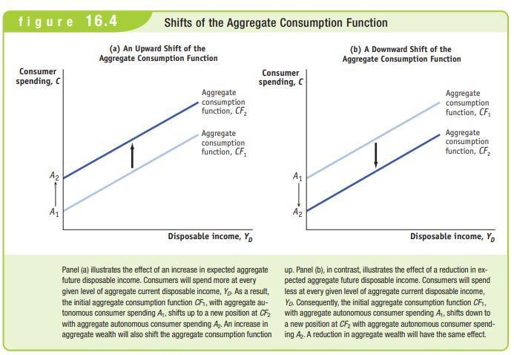

Slide 72
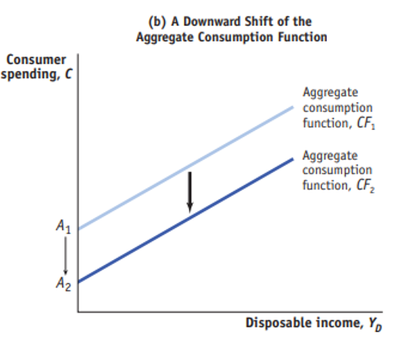
Draw a negative shift in autonomous consumption on a consumption function graph.
What could have caused this change?
Decrease in wealth or wealth expectations
Decrease in future Income Expectations

Slide 73
Change in MPC
C_{MPC increase}
Change in MPC will change the slope.
Increase MPC = more steep
Decrease MPC = less steep
C_{MPC decrease}
Change in the MPC could be caused by changes in:
Consumer confidence
Consumption tax rates
(tax paid when you buy goods and services)
Attractiveness of imports

Slide 74
Effect of Different Taxes
Tax Type | Effect on Consumption Function
Income Tax | Affects Y_{D} (people have less income to spend)
Consumption Tax (eg. Tax on food) | Affects MPC (purchases will be taxed)
Lump Sum Tax | Doesn’t affect MPC, only ‘a’ (because it affects wealth)
A lump sum tax (which is a somewhat theoretical tax as it does not occur in the real world very often) is an amount that is paid and does not change with income or consumption.
Eg. Every individual must pay $1000 tax.
Because income does not affect the amount of tax paid in the case of a lump sum tax, the MPC will be unchanged.
However it will affect the wealth of an individual and therefore affect a – autonomous consumption.
Whenever you see a lump sum tax, you can assume that the slope of the consumption function will be unchanged.
Summary
Lump sum taxes don’t affect the MPC

Slide 75
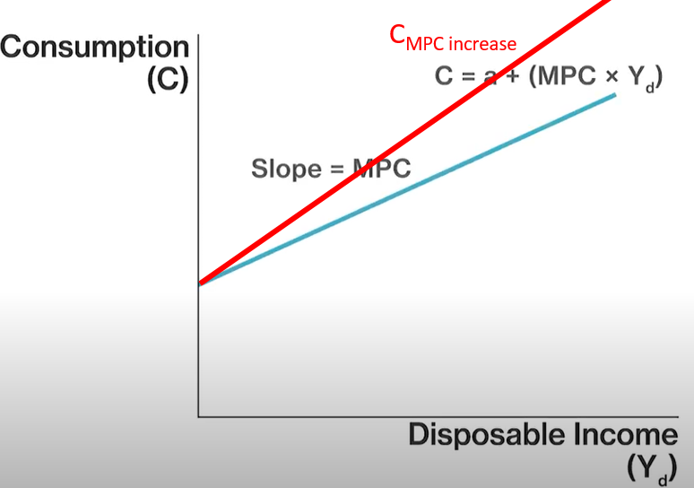
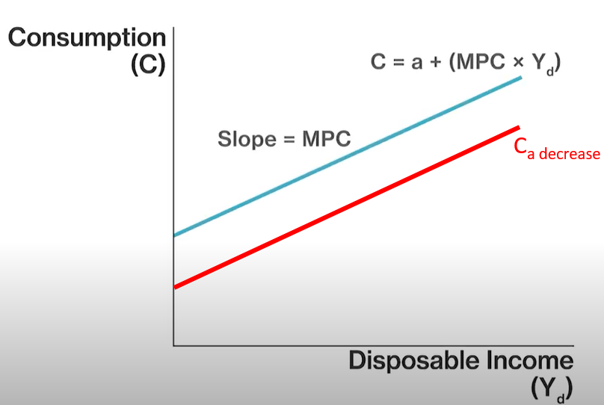
Draw the effect of an increase in the MPC on the consumption function.
Autonomous consumption has decreased. What is the effect on the consumption function?

Slide 76
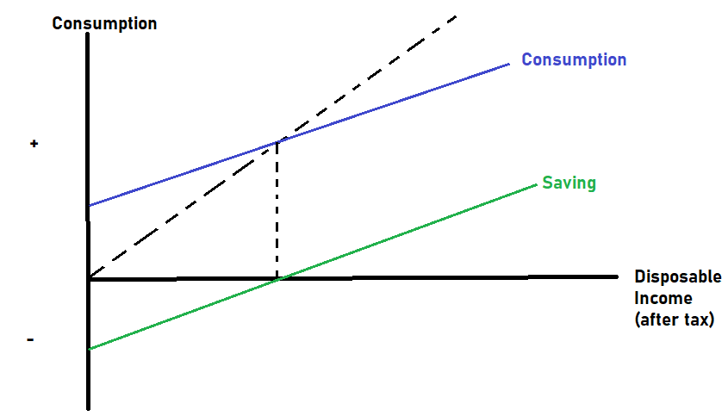
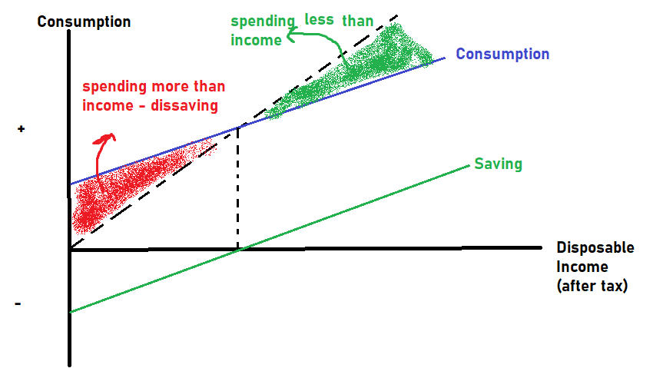
Saving and Dissaving
One interesting conclusion: Low income people spend a higher percentage of their income than higher income individuals.
So if we want to use Fiscal policy to stimulate the economy it is often more effective to give money to lower income citizens.
We can use a 45° degree line to show when we are saving and dissaving.
The 45° degree line shows when consumption and income are equal.
When consumption is above the 45° line - dissaving
When consumption is below the 45° line – saving
saving
Saving and the MPC
Note that the amount of saving will decrease if the MPC is higher.
Saving will increase if the MPC is lower.
45°
Note: The fact that poorer people spend more and rich people save is one of the reasons why increasing social welfare has a positive effect on AD. It is assumed that poor people will be spending on essentials and not saving.
Summary
Consumption below the 45 degree line - saving, showing that not all income is spent.
Consumption above the 45 degree line – dissaving (using up our savings)

Slide 77
The following consumption function shows:
Saving
Dissaving (using up old savings)
Consumption = Income
Answer:
Saving (consumption is less than the 45 degree line.)
45 degrees

Slide 78
Complete Module 16

Slide 79
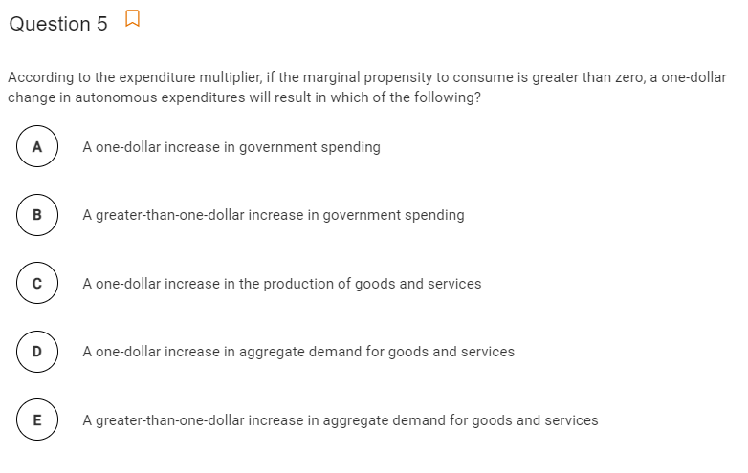
This is really just a fancy way to say – consumption, C, has increased.
When spending increases there is a multiplier effect.
So this is just a typical multiplier question with confusing terminology.
Answer: E

Slide 80
Unit 3 Progress Check Questions to finish
4, 5, 6, 24
Related to multipliers

Slide 81
A Level Unit 3 Questions

Slide 82
Classical vs Keynesian Aggregate Supply

Slide 83
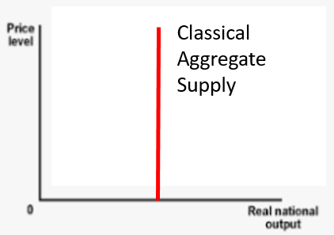
Classical AS Curve
While, nowadays we tend to split the AS curve into two curves, SRAS and LRAS, this was not always the case.
Classical economists believed that the aggregate supply curve is vertical.
The resources and technology of the economy would always determine output.
It assumes that wages and resource costs will adjust immediately ie. No sticky wages.
As a result of this vertical shape, they also did not believe in fiscal policy.
Because it would simply change the price level but not change output!
Summary
The classical aggregate supply curve is vertical.
Classical economists assume that wages are always flexible (not sticky).

Slide 84
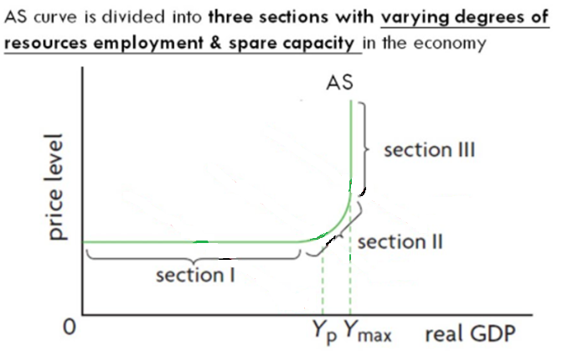
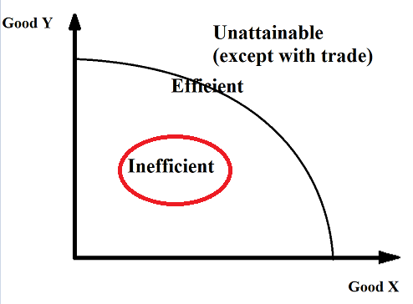
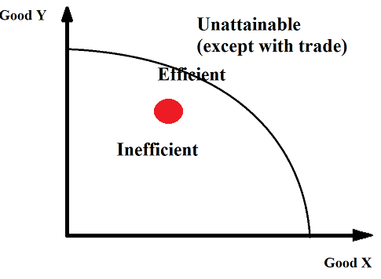
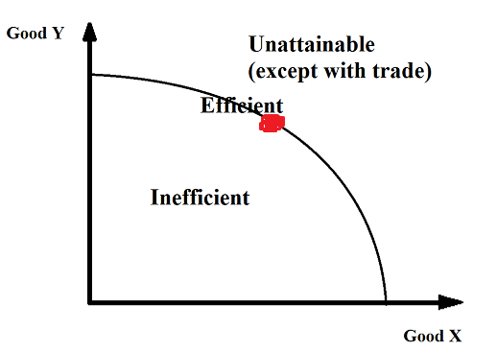
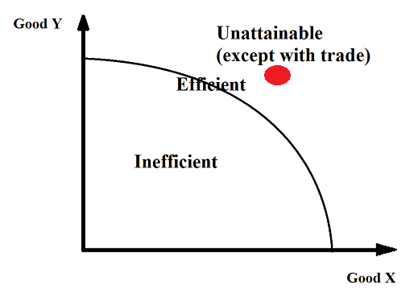
Keynesian Aggregate Supply Curve
Summary
The Keynesian AS curve has 3 sections.
Flat part = Keynesian range = many idle resources
Upward sloping = intermediate range = some scarcity
Vertical part = scarcity, can’t produce beyond this point.
Keynes was in favor of fiscal policy by governments when the economy went into recession.
This was driven by his view on the Aggregate Supply Curve.
Spare Capacity (Section 1)
One of the reasons for this was that economy’s have ‘spare capacity’ when output falls to a certain level.
Spare capacity means that in a recession, many resources are idle, and the economy can increase output significantly if demand increases.
This results in the SRAS being very flat, over the range that would be associated with a recession. It is sometimes called the ‘Keynesian range’.
Intermediate Range (Section 2)
Over this range resources are becoming more scarce, but the sticky wages still create an upward slope.
This is the typical range that we see when we study the SRAS in our modern model.
Scarcity (Section 3)
As resources become more scarce this results in the AS being vertical in the positive output gap range.
This is the classical view of supply, so this section is sometimes called the ‘classical range’.

Slide 85
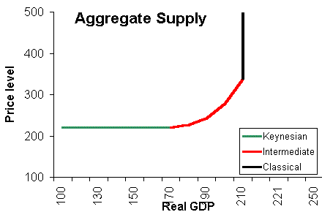
Draw the Classical Aggregate Supply Curve.
What assumptions does the classical supply curve have?
Draw the Keynesian Aggregate Supply Curve.
Label the three sections.
Scarcity – all resources being used
Intermediate Range
Spare capacity range – idle resources
Completely flexible wages. Output will always be at the same level.

Slide 86
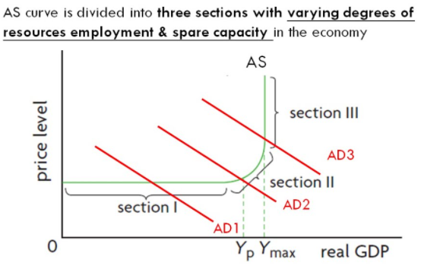
Fiscal Policy and the Keynesian Supply Curve
If we assume the Keynesian supply curve, we can see that when AD is low, the economy will likely enter a recession.
Therefore, expansionary fiscal policy will be very effective if we are in the horizontal part of the AS curve.
Summary
If we are on the flat part of the Keynesian supply curve, expansionary fiscal policy will be very effective.

Slide 87
What section of the Keynesian AS curve will see the most efficient expansionary fiscal policy?
The flat part of the curve ie. Spare capacity.
Which section of the Keynesian AS curve will see a purely inflationary effect from expansionary fiscal policy?
The vertical part of the curve where we are reaching a point of scarcity.

Slide 88
Classical AS Curve vs Keynesian AS Curve Summary
Classical AS
Classical economics came before Keynesian economics
Assumes always flexible wages, no sticky wages
Changes in AD will have no effect on output
The economy immediately adjusts to stay at long run output level, Y_{P}
Keynesian AS
Keynesian economics emerged after the Great Depression which started in 1929. Has 3 sections
The flat section is caused by sticky wages and the fact that the economy has spare capacity where not all resources are being used
Changes in AD, such as expansionary fiscal policy will have great effect when the economy is in a recession.
The economy can often be producing below Y_{P} and may take a long time to adjust
John Maynard Keynes famously quipped “In the long run we’re all dead.”

Slide 89
End of Unit 3

Slide 90
Revision Sheets
Unit 3 Study Guide
Unit 3 Practice
AP Progress Check

Slide 91
Unit 3 Quiz Coverage
Key Skills
AD/AS Graph
Able to draw and interpret the graph
Unemployment, Inflation, Stagflation, PPC, Business Cycle
Changing Equilibrium, Output Gaps, Full Employment
Long Run Self Adjustment
Be able to draw long run self adjustment in a negative output gap and positive output gap
Fiscal Policy
Expansionary – fight recession
Contractionary – fight inflation
Automatic Stabilizers vs Discretionary Fiscal Policy
Multiplier effect
Be able to calculate the multiplier and the ∆GDP
Tax Multiplier vs Spending Multiplier
3.1 Aggregate Demand (AD) Module 17
3.2 Multipliers Module 21
3.3 Short-Run Aggregate Supply (SRAS) Module 18
3.4 Long-Run Aggregate Supply (LRAS) Module 18
3.5 Equilibrium in the Aggregate Demand–Aggregate Supply (AD–AS) Model Module 19
3.6 Changes in the AD–AS Model in the Short Run Module 19
3.7 Long-Run Self-Adjustment Module 18
3.8 Fiscal Policy Module 20 Module 21
3.9 Automatic Stabilizers Module 21

Slide 92
Quiz – Unit 1 - 3

